Slide 1
Capstone Design Proposal Presentation

Slide 2
Meet the Team
1
ㅇ
AN JISU
LEE HYUNJAE
JEON JINWOO
Jane Doe
Jane Doe
Jane Doe
BACKEND DEVELOPER
backend developer
FRONTEND DEVELOPER
Server management, Server-side development
Database, Server-side development
Highlight algorithm, Dashboard UI
ajs7270@gmail.com
leehj8687@email.com
zinuzian@gmail.com
Notes:
© Copyright Showeet.com – Creative & Free PowerPoint Templates

Slide 3
Contents
9th week’s progress
Additional works
Schedule
Q&A

Slide 4
9th week’s progress
Chat analyze algorithm development – Hyunjae
Sectioning high ranked timelines - Jinwoo
Video Split and Merge - Jisu

Slide 5
9th week’s progress
Chat analyze algorithm development – Hyunjae

Slide 6
Chat analyze algorithm development
Chat Analyze
Chatlog
Dictionary
{ Each time : Score }
Labeled
words

Slide 7

What are Inputs?
00:01:00 chat context1
00:01:00 chat context2
00:01:03 chat context3
…
Chatlog
Labeled
words
PogChampNet [Reference Link]
Twitch emotes [Reference Link]
Kappa, trihard, pogchamp, 4head, cmonbruh, lul, hahaa, sourpls, feelsbadman, feelsgoodman, gachigasm, monkas, poggers, pepehands, destructroid, jebaited

Slide 8
Chat analyze algorithm
Chat Analyze
Scoring each timeline
if there is a labeled word in the context of the time

Slide 9
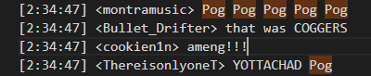
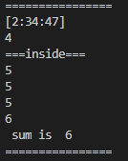
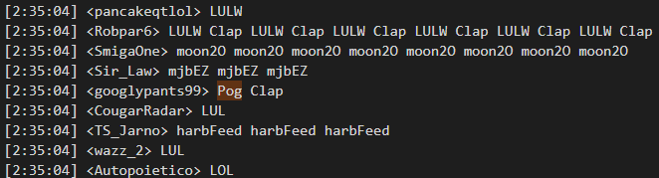
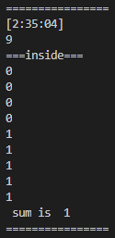
Detail example
The number of person who chatted at this time
Nicknames who chatted will be ignored
in our algorithm

Slide 10
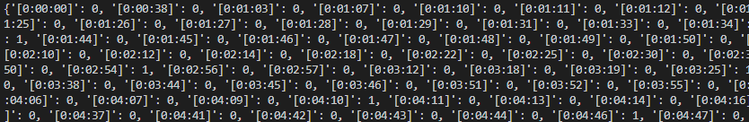
What are outputs?
Dictionary
{ Each time : Score }

Slide 11
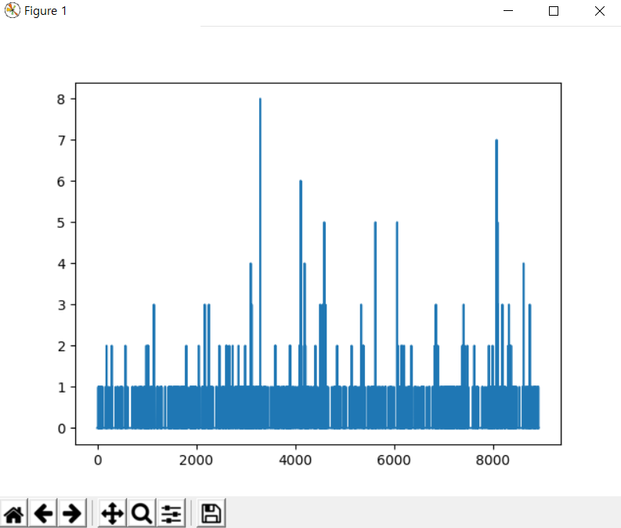
What are outputs?
Dictionary
{ Each time : Score }

Slide 12
Improvements
Top 10 most common Term Frequency words
Append to Labeled words [Local]
Chat Analyze
Chatlog
Dictionary
{ Each time : Score }
Labeled
words
[Global]

Slide 13
9th week’s progress
2. Sectioning high ranked timelines - Jinwoo

Slide 14
time stamp to section
From given timestamps,
make highlight sections with given delay
2 * delay
section[0]
section[1]
section[2]
section[3]

Slide 15
What if?
There can be some intersections

Slide 16
collision
Since we get bunch of highlight candidates, we delete following one

Slide 17
What if?
Out of range error can happen

Slide 18
Cuf off
The highlight should be finished in time

Slide 19
9th week’s progress
3. Video Split and Merge - Jisu

Slide 20

9th week’s progress
Video merge and split

Slide 21
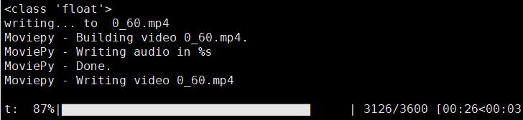
Implementation & Testing
Split video
Original file size : 16G
processed time : 30 sec (split to 1min)

Slide 22
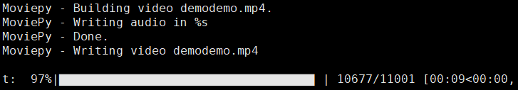
Implementation & Testing
merge video
Original file: two video (12M for each)
processed time : 10 sec

Slide 23
Development plans
Week | Plan
1st | Idea & Proposal
2nd | Idea & Proposal
3rd | Server construction (Configuration setup : Nginx, domain(bind9), https), Test videos (Twitch/Game/Eng)
4th | Login (SNS), Database
5th | Video upload & download, Twitch chat API analyze
6th | Frame resizing, Web UI, Designing highlight algorithm
7th | Demo

Slide 24
Development plans
8th | Highlight video analyze algorithm development and test
9th | Highlight video analyze algorithm development and test
10th | Highlight video analyze algorithm development and test
11st | Toss (payment), Test
12nd | Notification mail, Server test
13rd | Preparing for Final demo
14th | Final demo
15th | Final report

Slide 25
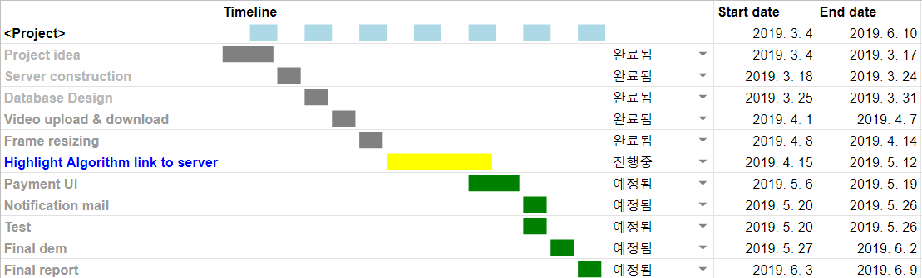
Development plans
Jisu An,

Slide 26
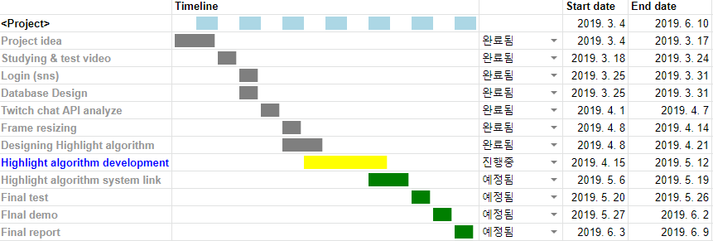
Development plans
Hyunjae Lee,

Slide 27
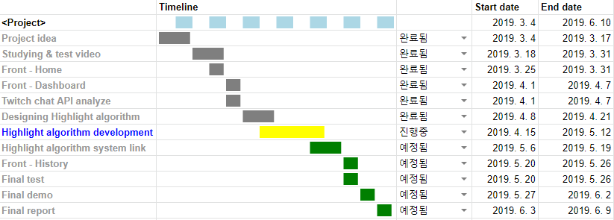
Development plans
Jinwoo Jeon,

Slide 28
Thank you!

